Slide 1


Clustering Analysis of U.S. Power Plants Using 2023 PUDL Data
FUNDAMENTALS OF MACHINE LEARNING BA 64060 Final Project
Group 2: Kyle Beeden, Melissa Dennis, and Stephen Gombos
Notes:
Welcome to our final project presentation for Fundamentals of Machine Learning. Our team analyzed the Public Utility Data Liberation dataset from 2023 and applied clustering techniques to better understand the patterns in fuel consumption and electricity generation across power plants in the United States. In this presentation we will walk through our approach, our findings, and the insights that can help inform top level management decisions.

Slide 2

Executive Summary
Key Points:
Analyzed PUDL EIA-923 year-to-date generation and fuel data
Applied k-means clustering to identify meaningful groups of power plants
Three clear clusters emerged
Nuclear and coal plants with high output
Natural gas plants with high consumption
Solar plants with low consumption and lower output
Insights help clarify technology roles in U.S. power generation
Notes:
This project examined year to date fuel consumption and electricity generation data from the Public Utility Data Liberation project. Using k means clustering we identified three meaningful groups of power plants in the United States. These groups differ in their fuel use, generation output, and the types of technology they rely on. One cluster represents high output nuclear and coal facilities. Another includes natural gas plants with high fuel consumption. The final cluster includes solar plants with near zero fuel use and lower overall output. These findings help reveal how different technologies contribute to the national power system.

Slide 3
About PUDL:
An open-source data platform that simplifies U.S. energy data.
Dataset Used:
EIA-923 (2023 Year-to-Date)
Includes generation and fuel usage
Over 17,000 plant-level records
Covers all U.S. geographic regions
Introduction to PUDL and the Dataset
Why YTD Data?
Provides standardized annual-level summaries suitable for clustering.
Notes:
The Public Utility Data Liberation project makes large and complex government datasets easier to analyze. For this project we used the EIA nine twenty three dataset that captures monthly and year to date electricity generation and fuel consumption. The dataset includes more than seventeen thousand records from plants across all regions of the United States. Because the year to date fields summarize activity across the full year they provided a consistent basis for clustering.

Slide 4

Data Cleaning and Preparation
Steps Taken:
Removed header rows not part of the data
Cleaned column names
Selected the six year-to-date fields
Converted variables to numeric
Removed one incomplete observation
Scaled numeric fields prior to clustering
First
Second
Third
Fourth
Fifth
Sixth
Outcome:
Clean, standardized dataset ready for k-means analysis.
Notes:
Before performing any analysis we prepared the dataset to ensure accuracy. We removed header rows that were not part of the usable data. We cleaned column names so they could be handled consistently. The six year to date variables were selected and converted to numeric values. We then removed one row that contained missing identification information. Finally we standardized all numeric variables so they would contribute equally to the k means clustering process. This prevented variables measured in larger units from overpowering the other variables used.

Slide 5
Problem Statement
Guiding Questions:
What is the optimal number of clusters?
What natural groups appear in the data?
What characteristics define these groups?
Are any clusters unusual or requiring further investigation?
Notes:
Our analysis was guided by four central questions. First we asked how the optimal number of clusters should be chosen. Second we wanted to identify what natural groupings appear within the power plant data. Third we explored which characteristics define each group. Finally we examined whether any clusters show unusual or extreme behavior that requires closer attention.

Slide 6


Method: K Means Clustering
Variables Used:
• Total fuel consumption
• Electric fuel consumption
• Energy content in MMBtu
• Net generation in megawatt-hours
Why K-Means:
• Effective for grouping similar observations
• Interpretable and suitable for numeric energy data
Preprocessing:
All variables standardized to ensure equal weight.
Notes:
We selected k means clustering because it is an effective method for grouping observations based on similarity and it also is easy to interpret. The variables included in our model were fuel consumption quantities, the energy content of fuel in million British thermal units, electric fuel consumption, and net electricity generation. Standardization ensured that each of these measures contributed equally to the distance calculations that drive the k means algorithm.

Slide 7
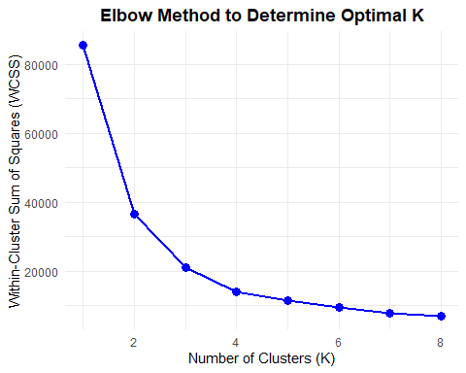
Choosing K:
Elbow Method
Finding:
Most pronounced bend appears at K = 3, indicating diminishing returns beyond that point.
Notes:
We first used the elbow method to determine how many clusters should be created. The plot of within cluster variation showed a noticeable bend at three clusters. This suggested that adding additional clusters beyond three did not substantially improve the segmentation of the data.

Slide 8
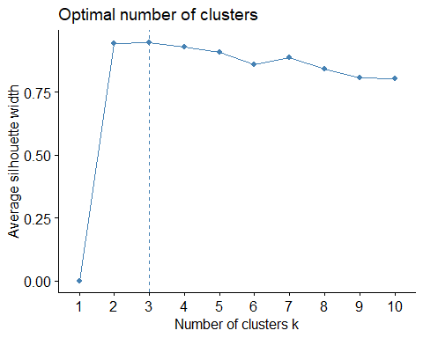
Choosing K:
Silhouette Method
Finding:
Peak silhouette width at K = 3, confirming the elbow result.
Notes:
To confirm our choice we also examined the silhouette method. The silhouette scores were highest at three clusters. This indicated that the observations were most clearly separated and most internally consistent when grouped into three segments. Both methods supported the same conclusion.

Slide 9
Cluster Sizes:
Cluster 1 High Output Nuclear and Coal: 156 plants
Cluster 2 Natural Gas: 305 plants
Cluster 3 Solar: 16,643 plants
High fuel consumption
High electricity generation
Concentrated in Illinois, Alabama, Washington, and Kansas
Extremely high consumption
Moderate to high output
Concentrated in Texas and Florida
Near zero fuel consumption
Low generation
Concentrated in California
Final Choice: K = 3
Justification:
Supported by both elbow and silhouette methods.
Notes:
Based on both methods we selected three clusters as the final solution. The resulting segments varied in size. One cluster contained a small group of highly specialized plants while the others represented larger segments of natural gas and solar facilities. This structure allowed us to meaningfully compare their characteristics.
The first cluster represents plants with high fuel consumption and high electricity generation. These include nuclear and large coal facilities which operate at high output levels. The second cluster is dominated by natural gas plants which consume large amounts of fuel and generate moderate to high levels of electricity. The third cluster represents solar plants which consume little to no fuel and produce lower levels of electricity compared to the other groups. These distinctions help clarify the role each technology plays within the national power system.

Slide 10
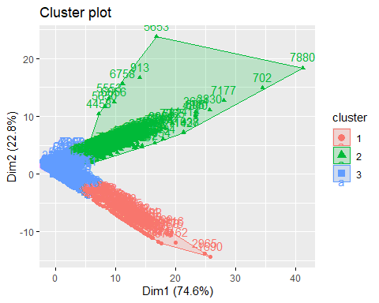
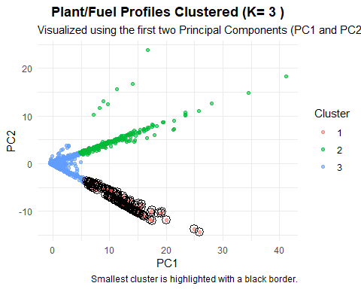
Notes:
We used principal component analysis to reduce the five numeric variables into two dimensions for visualization. When plotted in two dimensions the three clusters remained clearly separated. This further supported the validity of the segmentation and provided an intuitive view of how power plants differ in their operating characteristics.
We examined the smallest cluster more closely because small segments can sometimes signal anomalies. This group consisted largely of nuclear plants and a few coal plants that operate with high efficiency and large output. After reviewing the underlying data we found no errors. Instead we determined that these plants form a unique and legitimate operational category within the dataset.

Slide 11
Conclusion
Summary of Findings
Three meaningful clusters identified
Distinct technological and operational patterns
Demonstrates usefulness of PUDL for analysis
Key Assumptions:
Overall Contribution:
Standardization required
Fuel types used only for interpretation
Incomplete records removed
Provides a clear view of how different power plant technologies shape the U.S. energy landscape.
Notes:
Our findings offer meaningful insights for leadership. Nuclear plants deliver high and steady output which supports reliability. Natural gas plants show high consumption patterns and play an important role in meeting regional demand. Solar plants have minimal fuel use and add renewable capacity but operate at lower output levels. Regional patterns also emerged with nuclear concentrated in states such as Illinois and Alabama, natural gas concentrated in Texas and Florida, and solar concentrated in California. These patterns can help guide planning and policy decisions.
In conclusion, our clustering analysis identified three meaningful segments within year to date power plant data. These segments highlight how different technologies contribute to the overall structure of the United States power system. We made several assumptions including the need for standardization, the exclusion of incomplete records, and the decision to treat fuel types as descriptive rather than clustering variables. The analysis demonstrates the value of the Public Utility Data Liberation dataset and shows how clustering can provide useful insights for decision making.

